Slide 1
Machine Learning- introduction
ALCON
Warsaw, 13th Dec

Slide 2

Agenda for workshops:
15 Nov.
Introduction to ML, Unsupervised learning
29 Nov.
Supervised Learning
13 Dec.
End - to End machine learning project

Slide 3
Agenda for today:
16.00 - 16.05 | Kahoot!
16.05 - 16.15 | Supervised Machine Learning - new models
16.15 - 17.15 | Case study - data and model preparation
17.15 - 17.20 | Break
17.20 - 17.55 | Case study - model tunning
17.55 - 18.00 | QA

Slide 4


Slide 5
Supervised Learning Types
Algorithms | Problem categories
Linear Regression | Regression
Logistic Regression | Classification
K-NN (k nearest neighbors) | Regression and Classification
Support Vector Machine | Regression and Classification
Decision Trees | Regression and Classification
Random Forest | Regression and Classification

Slide 6
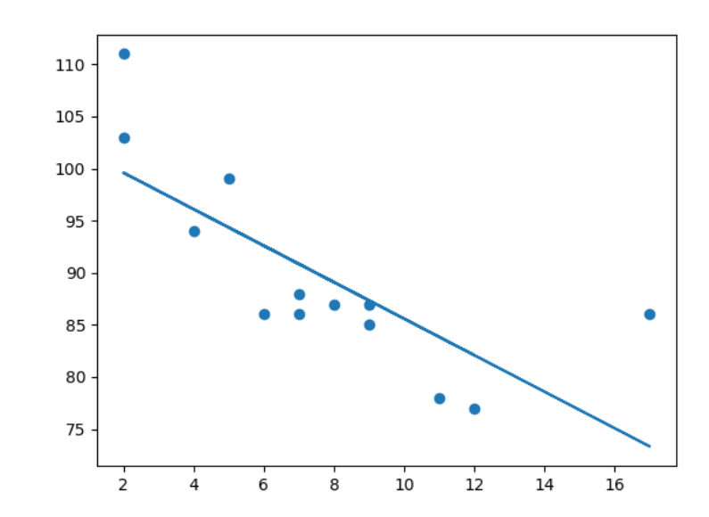
Linear regression / Logistic regression
Requires that the input features are numerical and scaled to similar ranges (e.g., to the [-1,1] interval)
Can perform purly if there is redundancy of the data →numerical instabilities → can be solved by regularization
If there are complex interactions among features - this is not the best algorithm!!!
sklearn.linear_model.LinearRegression
sklearn.linear_model.Ridge
sklearn.linear_model.Lasso
sklearn.linear_model.ElasticNet
Ridge
Ridge regression addresses some of the problems of Ordinary Least Squares by imposing a penalty on the size of the coefficients with l2 regularization.
Lasso
The Lasso is a linear model that estimates sparse coefficients with l1 regularization.
ElasticNet
Elastic-Net is a linear regression model trained with both l1 and l2 -norm regularization of the coefficients.
Linear regression uses the relationship between the data-points to draw a straight line through all them. This line can be used to predict future values.

Slide 7
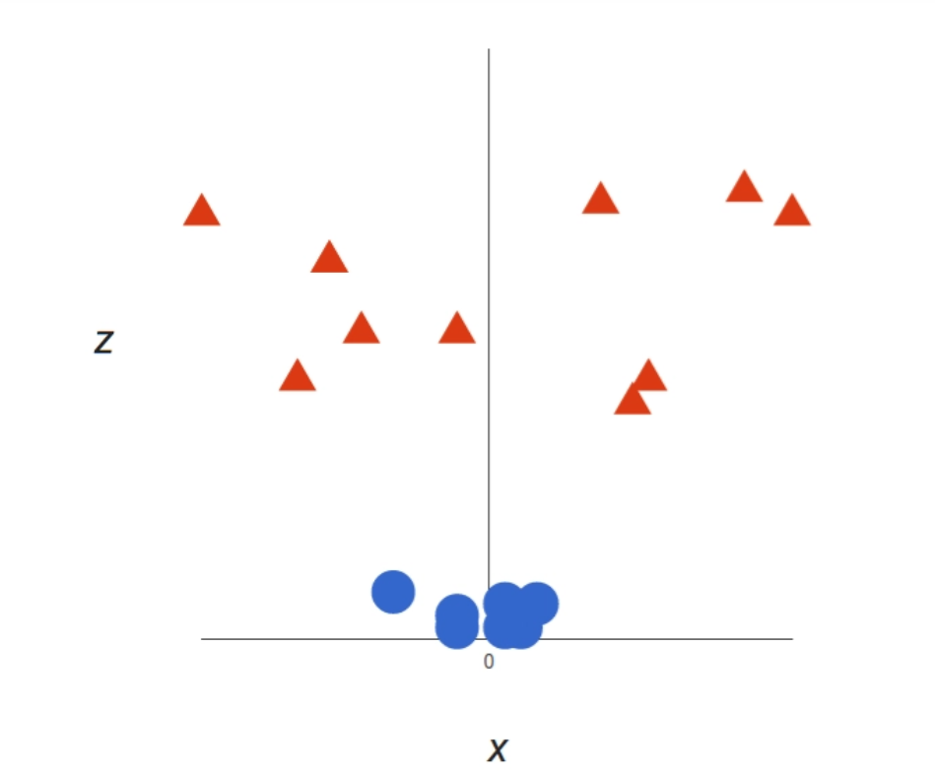
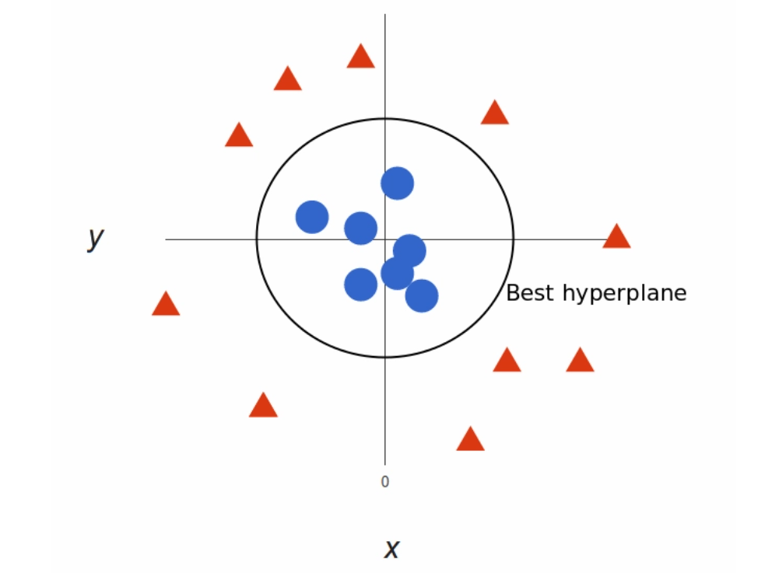
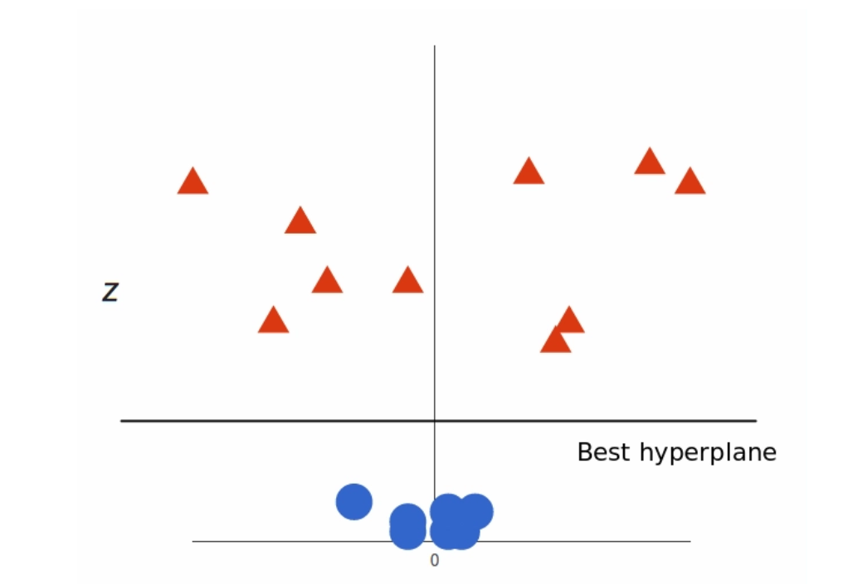
Support Vector Machine(SVM)
Support vector machine constructs a hyperplane or set of hyperplanes in a high or infinite-dimensional space, which can be used for classification, regression.
Good separation is achieved by the hyperplane that has the largest distance to the nearest training-data point of any class (so-called functional margin), since in general the larger the margin, the lower the generalization error of the classifier.
Very sensitive to data which are not scaled to similar range
Perform well in the presence of interactions and non-linearities
Non-linear and linear classifier
Prefered to be used for classification problem
For a large datasets SVM can be very slow →
If the number of features is much greater than the number of samples, avoid over-fitting in choosing Kernel function and regularization term is crucial.
Third dimension: we can easly seperate

Slide 8
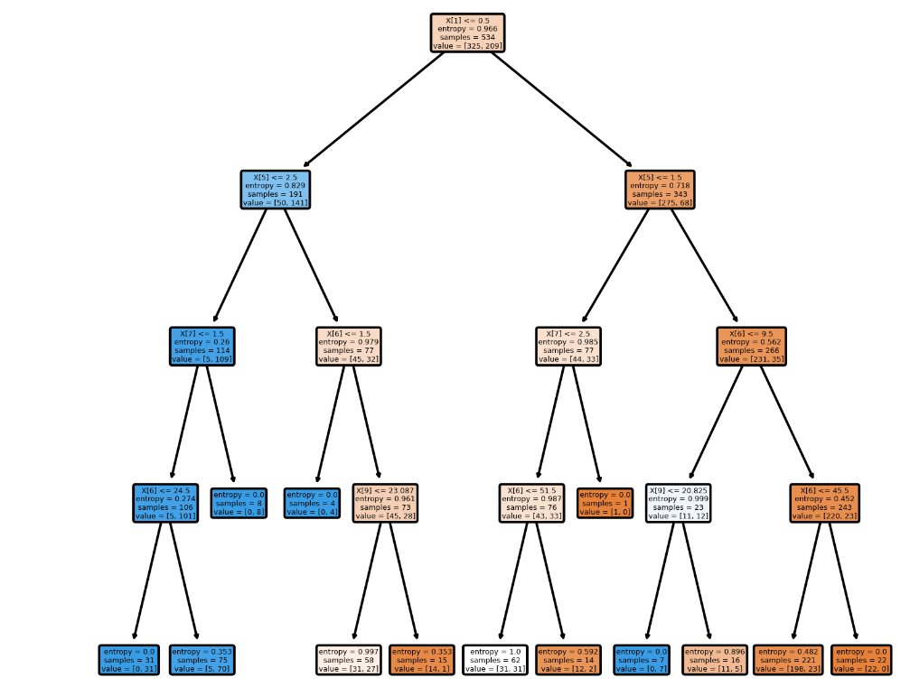
Decision Tree
Is a non-parametric supervised learning method
Works better with complex interaction of features
Can easily handle heterogeneous data
Simple to interpret and visualized
Can be unstable because small variations in the data might result in a completely different tree being generated → use an ensemble
If some classes dominate, we get biased results, we need to balance the dataset prior to fitting with the decision tree.

Slide 9
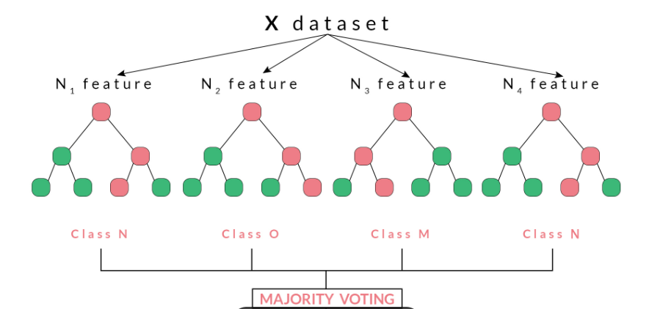
Ensemble methods
Random Forest/ AdaBoost/Gradient Tree Boosting
Works better with complex interaction of features
Can easily handle heterogeneous data
A random forest is a meta estimator that fits a number of decision tree classifiers on various sub-samples of the dataset and uses averaging to improve the predictive accuracy and control over-fitting.
from sklearn.ensemble import RandomForestClassifier
from sklearn.ensemble import ExtraTreesClassifier
from sklearn.ensemble import AdaBoostClassifier
from sklearn.ensemble import GradientBoostingRegressor

Slide 10
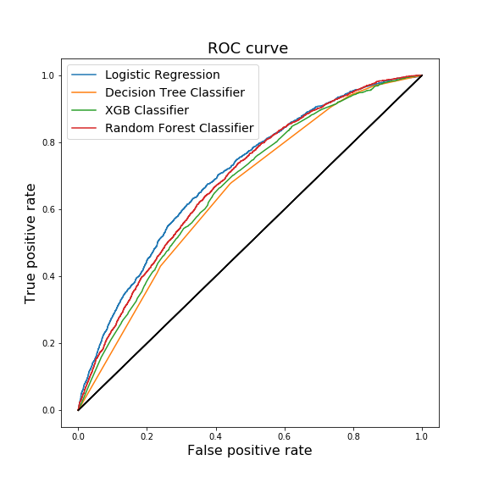
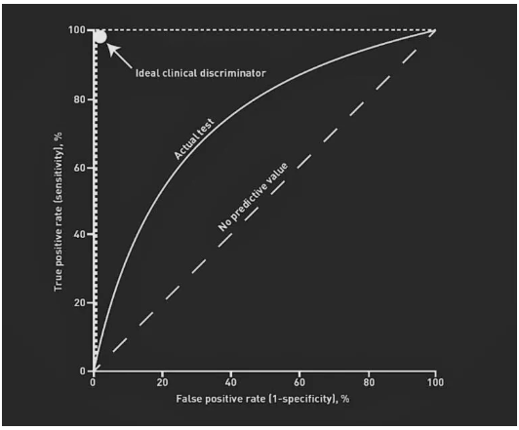
ROC curve
ROC stands for Receiver Operating Characteristic
convenient visual tool for analyzing different classification models
displays the trade-off among the true positive rate or sensitivity (proportion of positive tuples that are recognized) and the false-positive rate (proportion of negative tuples that are incorrectly recognized as positive) for a given model.
Given a two-class problem, it enables us to anticipate the trade-off between the rate at which the model can accurately identify ‘yes’ cases versus the rate at which it mistakenly recognizes ‘no’ cases as ‘yes’ for multiple “portions” of the test set.
The area under the ROC curve is an assess of the accuracy of the model (AUC).
As a baseline, a random classifier is expected to give points lying along the diagonal (FPR = TPR)
from sklearn import metrics
fpr, tpr, thresholds = metrics.roc_curve(y_test, y_score)

Slide 11
Model selection is the process of choosing one among a collection of candidate machine learning models for a training dataset.
Can be applied both across different types of models (e.g. logistic regression, SVM, KNN, etc.) and across models of the same type configured with different model hyperparameters
There may be many competing concerns when performing model selection beyond model performance, such as:
complexity,
maintainability,
and available resources.
The two main classes of model selection techniques are probabilistic measures and resampling methods.
Model selection is the process of selecting among model development pipelines. It requires different or overlapping computational steps, such as:
Data filtering.
Data transformation.
Feature selection.
Feature engineering.
Model selection(1)

Slide 13
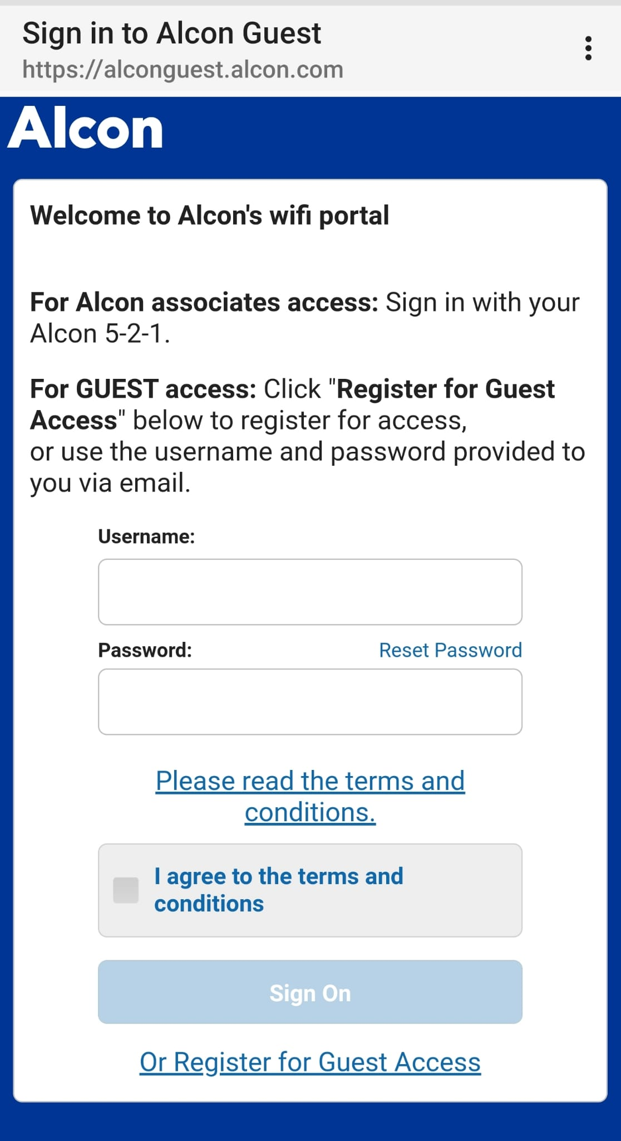
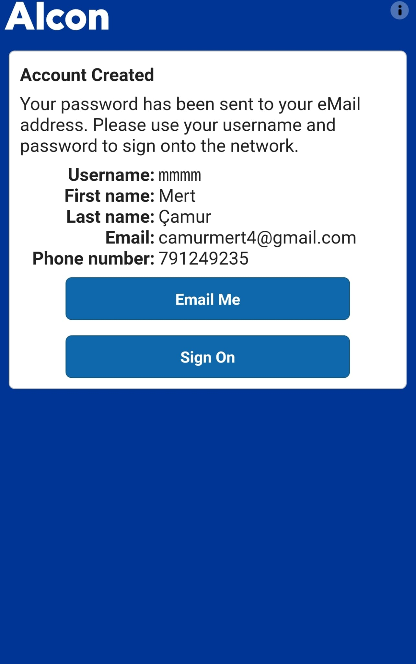
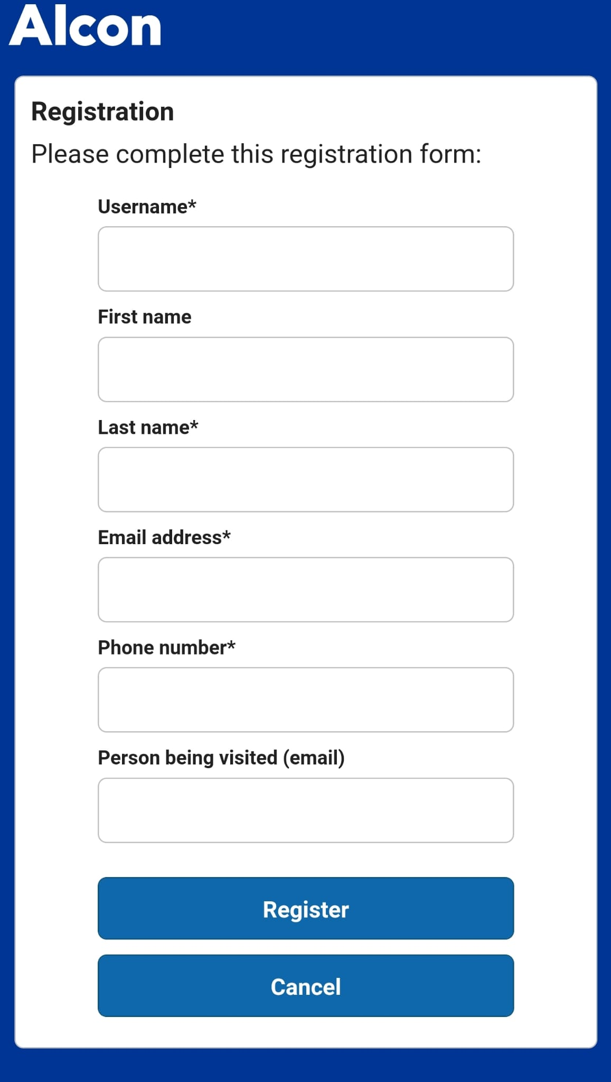
Example use in Python:
For Internet

Slide 14
Example use in Python:
For Exercise
https://github.com/Megrok/Clustering/tree/end-to-end-ml-project

